Slide 1
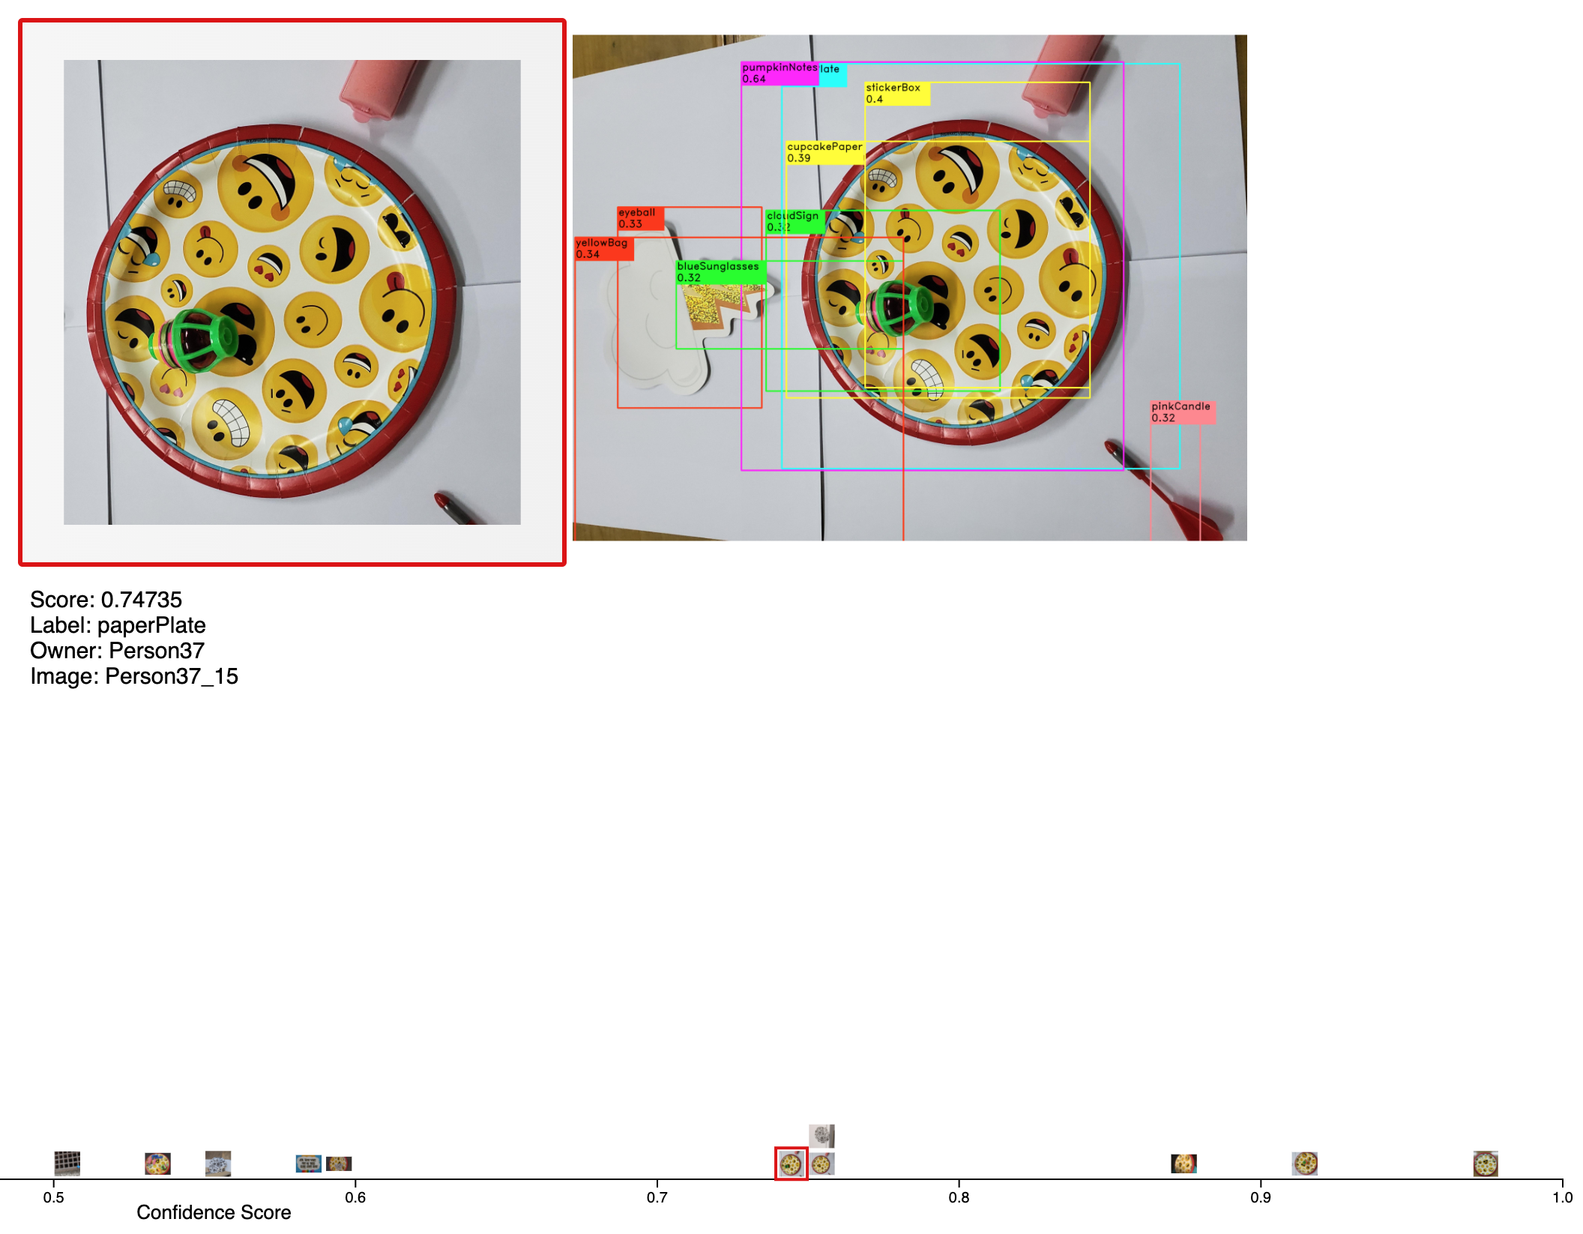

Slide 2
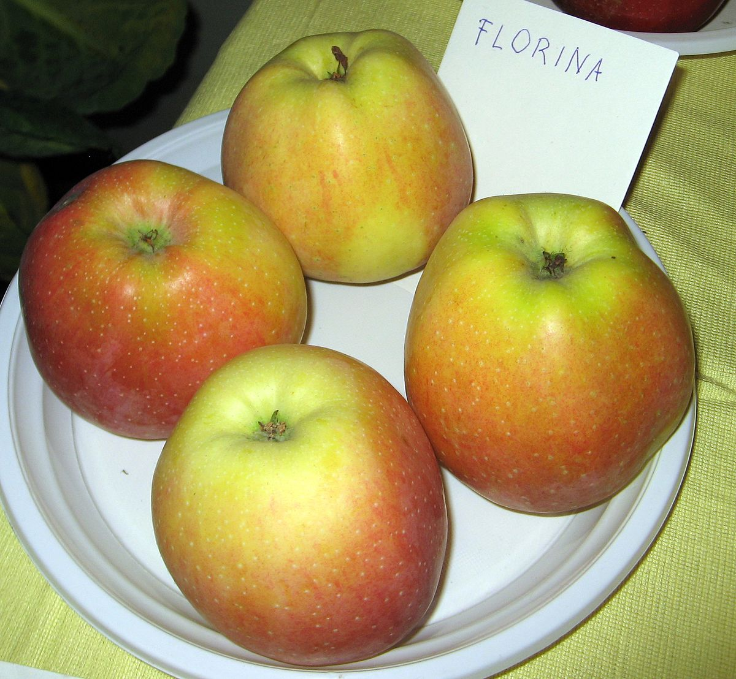
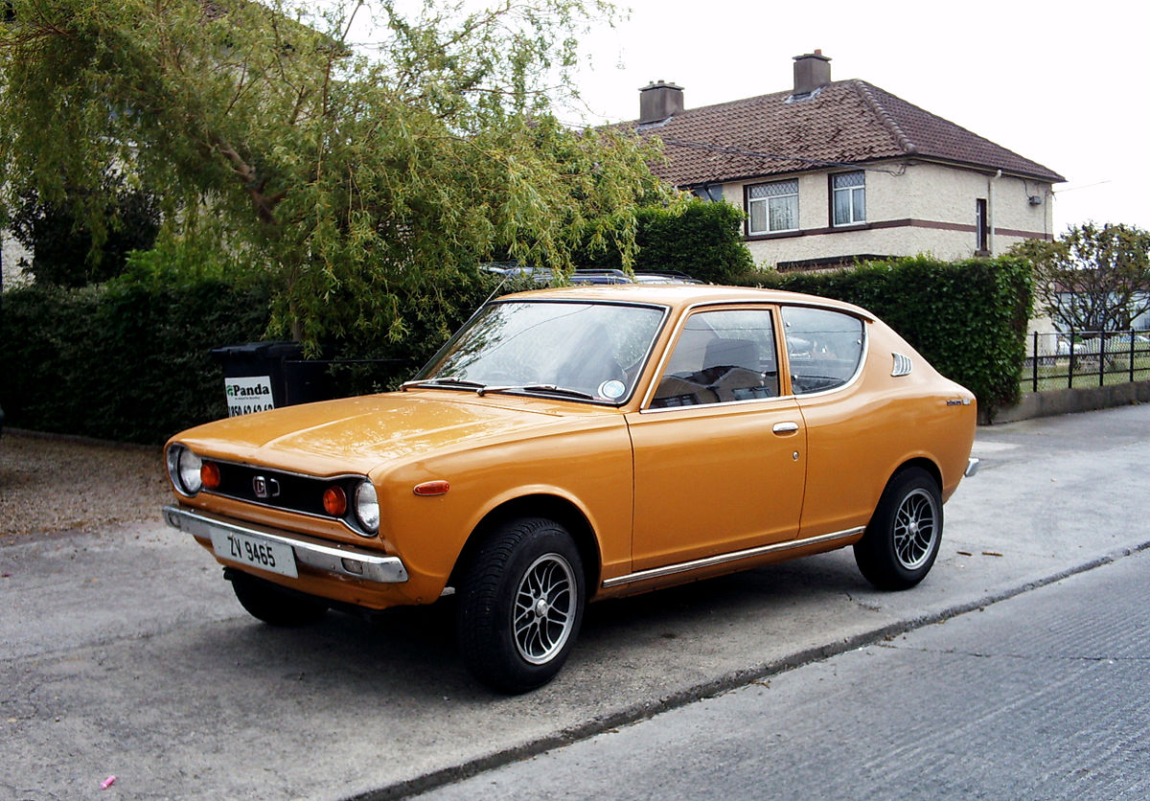
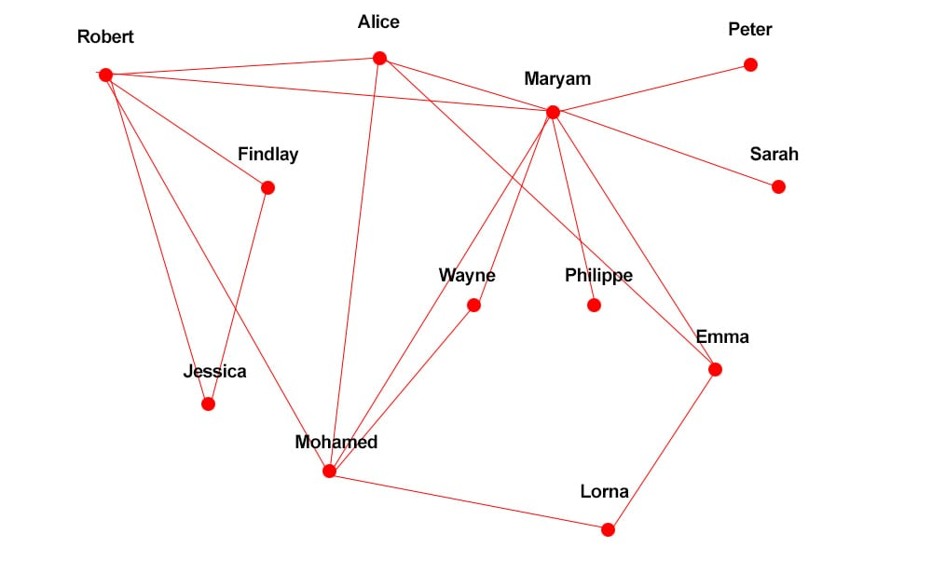
Examine objects
Label images
Image 1
Image 2
Image 3
Image 4
Image 5
Image 6
…
Horse
Car x
House x
Dice
Bag
Glasses
…
…
List Commonly mistaken labels
Plot Precision - Recall
Weight = Sum of confidence score

Slide 3
Uncertainty/Confidence
Understand results
Examine objects
Label obj TP/FP
Precision
Plot Precision - Recall
Track provenance
Evaluate classifier
List Commonly mistaken labels
Recall
help
Re-label images
Label FN
Uncertainty/Confidence
Improve results

